Slide 1
The Congress
AP U.S. Government Chapter 11

Slide 2
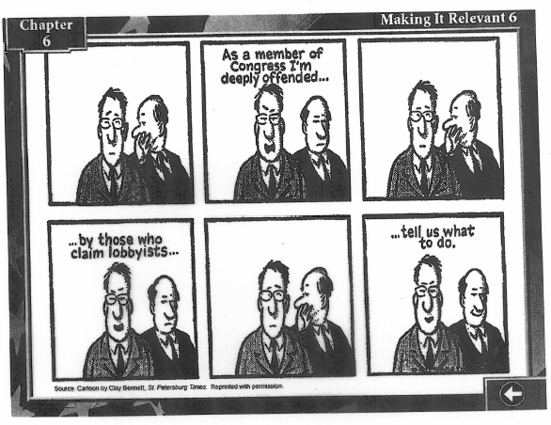

Slide 3
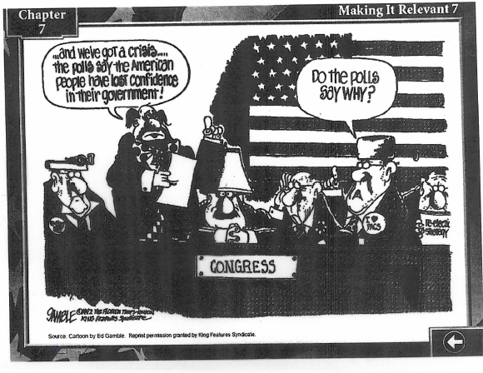

Slide 4
Why Was Congress Created?
Bicameralism
2-house institution
Different constituencies
House elected by the people (districts)
Senate selected by State Legis.
1913 17th amend.-people of State elect senators
State Legislatures:
http://thomas.loc.gov/home/state-legislatures.html
http://www.csg.org/

Slide 5
Functions of Congress
Lawmaking
Establish broad national policies, including budgetary policies or may establish minor regulations
Representation function
Trustee view-consider the whole of society
Instructed delegate view-doing what majority of constituents want
Politico style-combine both views
Service to Constituents
Case work-assisting constituents with governmental services
Ombudsperson-investigator of constituent problems

Slide 6
Functions continued
Oversight function
Responsible for reviewing actions of Exec. Branch (implementation and effectiveness)
Public-Education function
Agenda setting- inform public
Conflict Resolution function
Acts as an institution to resolve conflicts with Amer. society

Slide 7
Powers of Congress
Enumerated
Expressed powers- Article I, Section 8
Taxing, spending, borrowing, coining, regulation of foreign trade and interstate trade, regulation of the military
Powers of Senate- “advise and consent” to treaties and the appointment of top officials
Constitutional amendments
Necessary and Proper Clause
Implied powers- Article I, Section 8
Laws deemed necessary to carry out expressed powers
McCulloch v. Maryland

Slide 8
House and Senate Differences
Size and rules
House-435 members, 2 year term, large number- numerous rules, formal rules to govern activity
Senate-100 members, 6 year term (1/3 of seats up for election every two years), smaller number- fewer restrictions on members
Debate and Filibustering
Senate- filibuster, unlimited debate- cloture, 3/5 of senate vote and debate is limited to 1 hour per senator
Prestige
Senate- b/c longer term and fewer numbers, can achieve higher level of indiv. recognition

Slide 9
Congresspersons
Demographics
http://clerk.house.gov/member_info/cong.html

Slide 10
Congressional Elections and Campaigns
Fundraising
Presidential effects
Coattail effect
Power of Incumbency
90% of members of the House who sought reelection were reelected. 75% of Senate
Advantage of name recognition/media
Advantage in fundraising
2010 midterm election
http://www.msnbc.msn.com/id/21134540/vp/39408648#39408648
2014 midterm election
http://www.nbcnews.com/nightly-news/many-races-too-close-call-days-midterm-elections-n239201

Slide 11
Congressional Apportionment
Reapportionment-allocation of seats in the House after each census-> redistricting- redrawing the boundaries of the congressional districts
Gerrymandering- the practice of drawing district lines so that they favor one party over the other.
Packing-pack the other party’s supporters into the fewest number of districts to ensure that many of their votes will be wasted.
Cracked- the remaining supporters of the other party are split up among the remaining districts in numbers too small to affect an election
(Violates voters rights???)

Slide 12
Perks and Privileges
Permanent Professional Staffs
Privileges and Immunities under the Law- cannot be sued for slander for anything they say in Congress
Congressional Caucuses- Source of support, over 200 caucuses, ex: Congressional Black Caucus

Slide 13
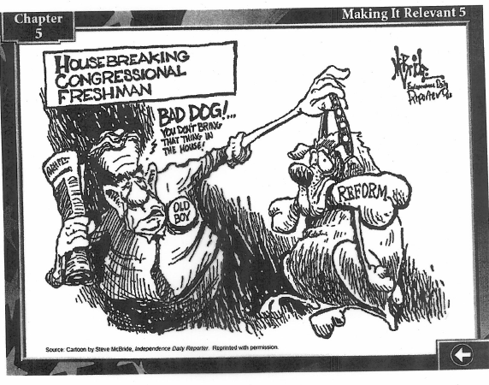

Slide 14
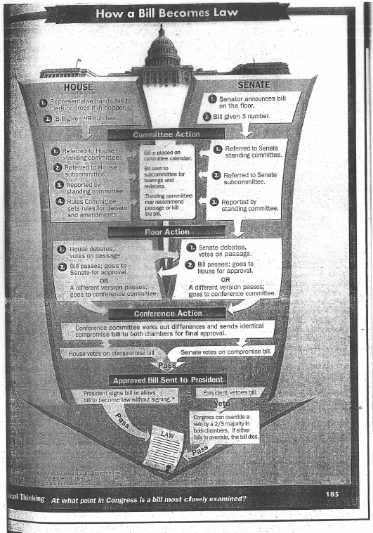

Slide 15
Committee Structure
Types:
Standing- most important, permanent, all bills referred to, covers area of specialization and is subdivided into subcommittees
Select- created to accomplish a particular task, temporary
Joint- members of each chamber
Conference- special joint committees convened when a bill passes both chamber, but there are different versions

Slide 16
Structure continued
House Rules- most powerful standing committee in the House of Rep., makes rules that will govern what happens to a bill on the floor
Selection of Committee members
Parties select, longer they serve, the more seniority
The most senior member of the majority party will be selected as the chairperson of the committee

Slide 17
Structured continued
Formal leadership
House
The Speaker- most powerful, presides over meetings, appoints members of joint and conference committees, controls scheduling of leg. for floor action, interprets rules, refers bills, primary focus- their political party’s leg. Ideas
Majority Leader- second in line to Speaker
Minority Leader- source of “loyal opposition” to majority
Whips- assist their party leaders and encourage loyalty

Slide 18
Structure continued
Formal Leadership
Senate
President of Senate- Vice Pres.
President Pro Tempore- member of the majority who has the longest continuous term of service
Majority leader
Minority leader
Whips

Slide 19
Current leadership
http://www.house.gov
http://www.senate.gov/pagelayout/senators/a_three_sections_with_teasers/leadership.htm

Slide 20
Woll Reading, Congress Bashing p408
What is Congress Bashing? P 409, 4th parag.
Polsby identifies 3 problems, describe each:
Item veto
Term limitations
Congressional salaries ($174,000, 2014)

Slide 21
Matthew’s reading: It’s Not Who You Know; It’s Who You Get To Know
1.What was so important about “the Dodge?”(p 24)
2.What is retail politics? (p 26)
3.What is the “Johnson Treatment?” (p 29)
4.What did Jody Powell (Carter Admin.) mean by “Neglected the Social?”(p 35)
5.How did G.H. Bush win the Persian Gulf War? (p 39)
6.How does Chris Matthews define patronage? (p 41)

